Slide 1
Heart Stroke Prediction
Departments: IT, ECE, CSE
Course Name: Bachelors of Technology
College: Asansol Engineering College
University: Maulana Abul Kalam Azad University of Technology (MAKAUT)
Instructor Name: Prof. Arnab Chakraborty
Semester: 5th
Date: 26-12-2025
1

Slide 2
Contents
Sl. No | Topic | Page No.
1 | Team Members | 3
2 | Introduction | 4
3 | Primary Objective & Scope | 5
4 | Data Descipton | 6-7
5 | Methodology | 8
6 | Data Preprocessing | 9
7 | Models Used and Elaborations | 10-15
8 | ROC Graphs of Models | 16-18
9 | Accuracy Comparision | 19
10 | Inference | 20
2

Slide 3
Team Members
Names | Roll Numbers | Roles | Department
Rhitinkar Bhowmick | 10800323048 | Data Preprocessing + Presentation | ECE
Pritam Roy | 10800223111 | Data Processing + ML Training + Presentation + Documentation | IT
Supritam Mukhopadhyay | 10800123232 | Frontend (Streamlit) Integration + Documentation | CSE
Srikanta Maji | 10800123219 | Data Visualization + Documentation | CSE
3

Slide 4
Introduction
Brief Background of the Problem:
Real-World Relevance (Healthcare Impact):
  Stroke is a serious medical condition caused by interrupted blood flow to the brain, often resulting in long-term disability or death.
  Early identification of individuals at risk is difficult due to the involvement of multiple health, lifestyle, and demographic factors.
  An accurate stroke prediction system can assist healthcare professionals in identifying high-risk individuals early.
  This enables preventive care, timely medical intervention, and better allocation of healthcare resources, ultimately reducing fatality rates and improving patient quality of life.
Why This Problem Is Important:
Stroke is one of the leading causes of mortality and permanent disability worldwide. Delayed diagnosis or lack of early warning signs significantly increases the severity of outcomes, making timely risk prediction extremely crucial.
4

Slide 5
Project Objectives & Scope
Primary Objective:
Scope of the Project:
  To develop a machine learning–based system that predicts the likelihood of stroke in individuals using demographic, lifestyle, and medical health data.
  Included:
    Analysis of structured healthcare data.
    Application of supervised machine learning models.
    Model evaluation using standard performance metrics.
    Basic frontend integration for user input and prediction.
  Excluded:
    Real-time clinical data integration.
    Medical diagnosis or treatment recommendation.
    Deployment in hospital-grade healthcare systems.
    Use of deep learning or real-time sensor data.
Secondary Objectives:
  To perform data preprocessing and handle missing and categorical values effectively.
  To train and evaluate multiple machine learning models for stroke prediction.
  To compare model performance using accuracy, precision, recall, and F1-score.
  To identify the best-performing model suitable for healthcare prediction.
  To deploy the trained model using a user-friendly web interface (Streamlit).
5

Slide 6
Data Description
The description of the data with type and description of each Attribute is given/shown in the table.
Attribute Name | Data Type | Description
id | int64 | Unique identifier (Dropped during modeling).
gender | object (Categorical) | Patient's gender (Male, Female, Other).
age | float64 | Age of the patient.
hypertension | int64 (Binary) | 1 if the patient has hypertension, 0 otherwise.
heart_disease | int64 (Binary) | 1 if the patient has heart disease, 0 otherwise.
6

Slide 7
Data Description
Attribute Name | Data Type | Description
ever_married | object (Categorical) | Whether the patient was ever married (Yes/No).
work_type | object (Categorical) | Patient's occupation (Private, Self-employed, Govt_job, etc.).
Residence_type | object (Categorical) | Type of residence (Urban/Rural).
avg_glucose_level | float64 | Average blood glucose level.
bmi | float64 | Body mass index (Missing values present).
smoking_status | object (Categorical) | Patient's smoking status (formerly smoked, never smoked, smokes, Unknown).
stroke | int64 (Binary) | Target Variable: 1 if the patient had a stroke, 0 otherwise.
7

Slide 8
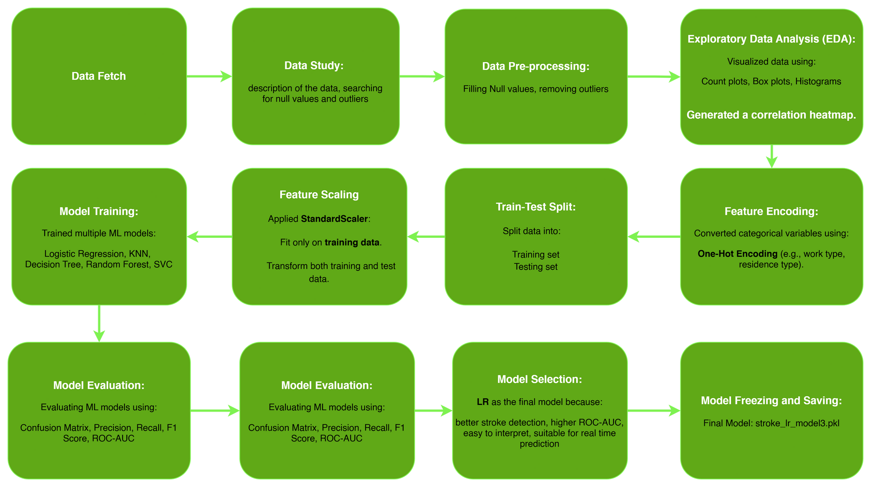
Methodology
8

Slide 9
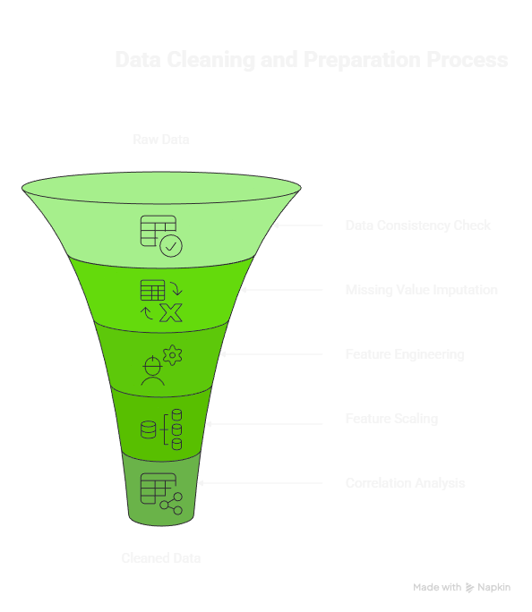
Data Pre-Processing
Step by Step:
1. Handling Inconsistent and Redundant Data:
  duplicate removal
  gender consistency
2. Missing Value Treatment:
  BMI Median Imputation
  Smoking Status Imputation
3. Feature Engineering and Encoding:
  Categorical Features
  Process, Dimensionality
4. Feature Scaling(Standardization)
5. Final Correlation
9

Slide 10
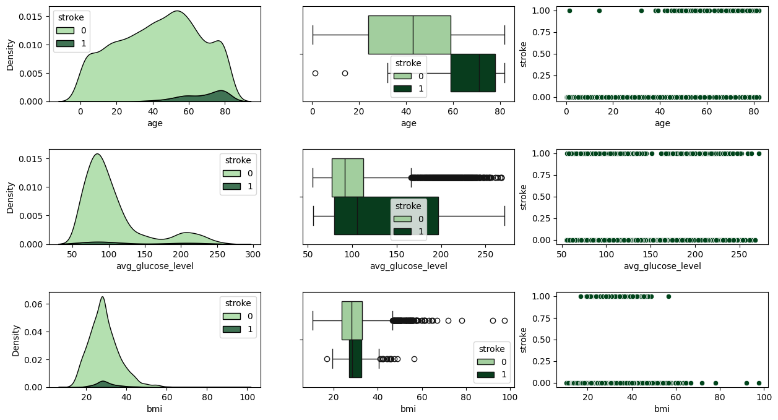
Data Visualization
10

Slide 11
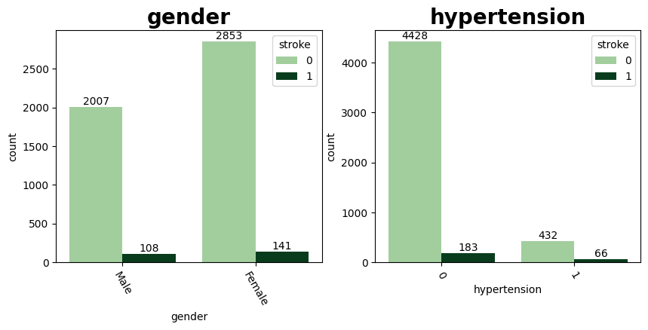
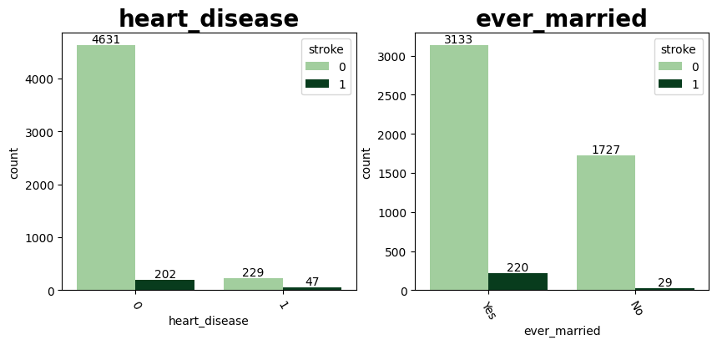
Data Visualization
11

Slide 12
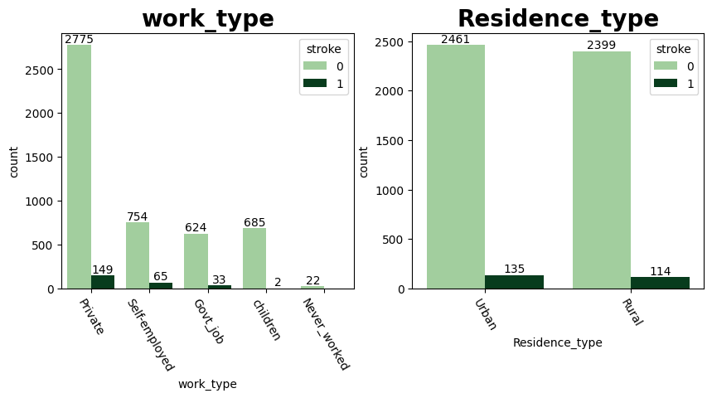
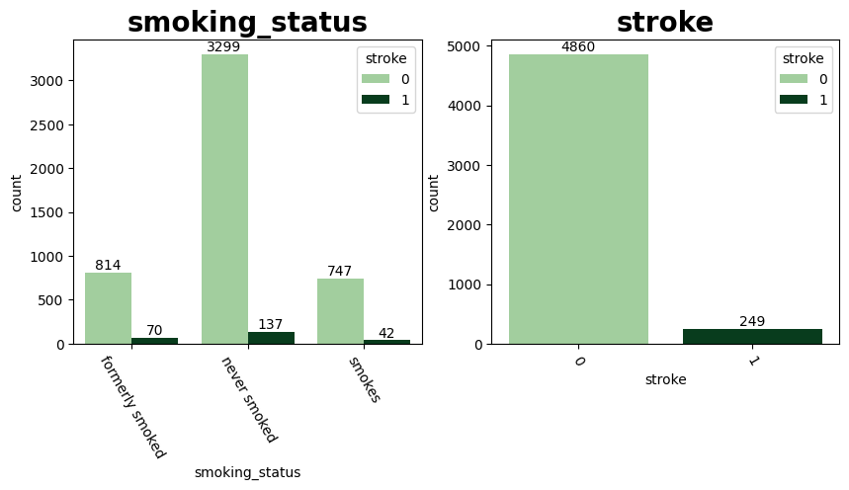
Data Visualization
12

Slide 13
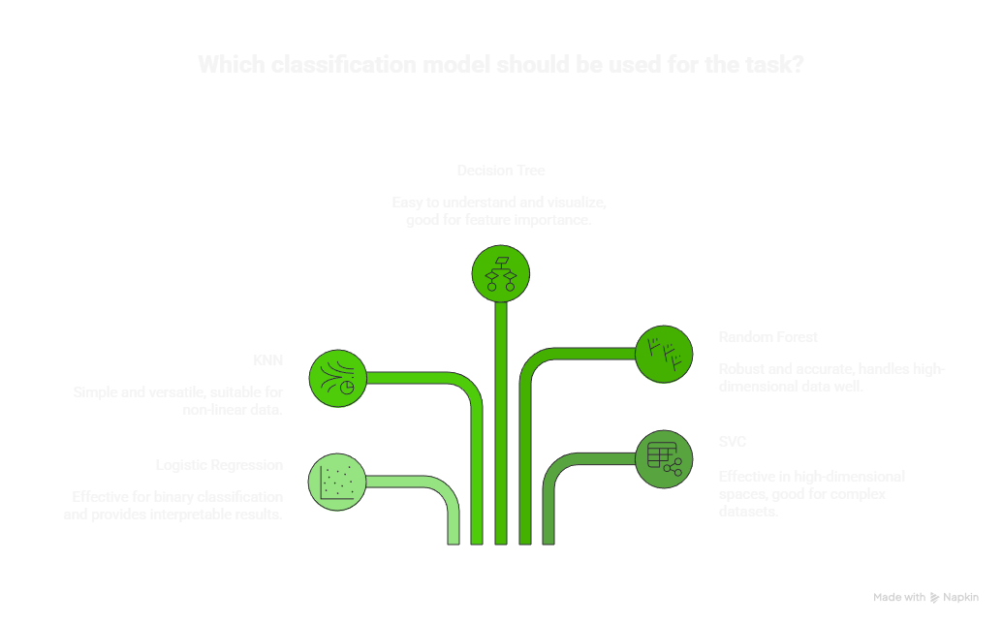
Models Used
13

Slide 14
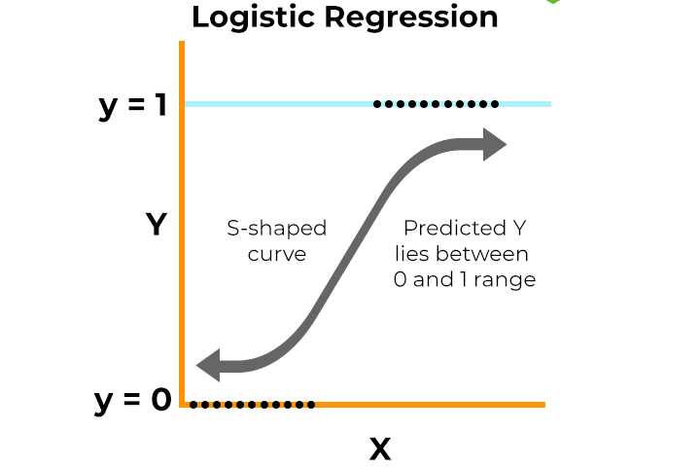
Logistic Regression
Logistic Regression is a statistical model used for binary classification problems.
How It Works:
  Calculates weighted sum of input features
  Applies sigmoid function to predict probability
  Outputs class based on threshold value
Advantages:
  Simple and fast model
  Easy to interpret results
  Works well as a baseline model
Applications:
  Disease prediction
  Spam detection
  Customer churn analysis
  Heart Stroke Prediction
14

Slide 15
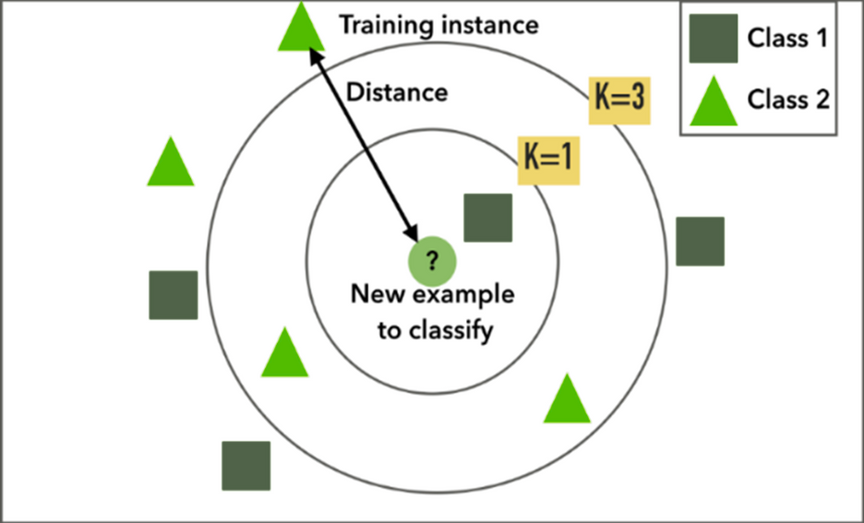
K-Nearest Neighbors (KNN)
KNN is a simple, instance-based learning algorithm that classifies data based on similarity to nearby data points.
How It Works:
  Calculates distance between new data and training data
  Selects the ‘K’ closest neighbors
  Assigns the class based on majority vote
Advantages:
  Easy to understand and implement
  No training phase required
  Effective for small datasets
Applications:
  Slow for large datasets
  Sensitive to choice of K and distance metric
15

Slide 16
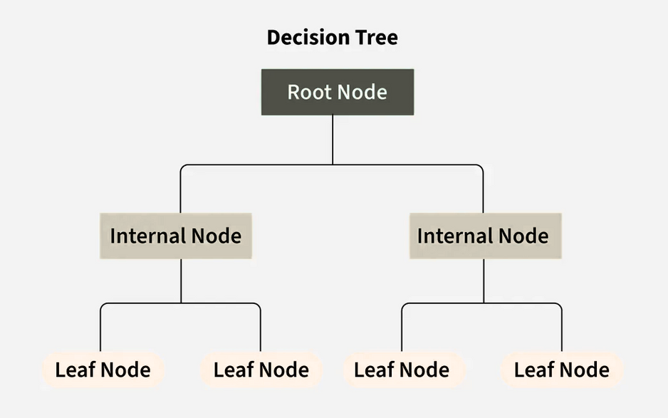
Decision Tree
Decision Tree is a flowchart-like model that makes decisions based on feature conditions.
How It Works:
  Splits data into branches using decision rules
  Each internal node represents a condition
  Leaf nodes represent outcomes
Advantages:
  Easy to understand and interpret
  Requires little data preprocessing
  Handles both numerical and categorical data
Applications:
  Can overfit the data
  Less accurate compared to ensemble methods
16

Slide 17
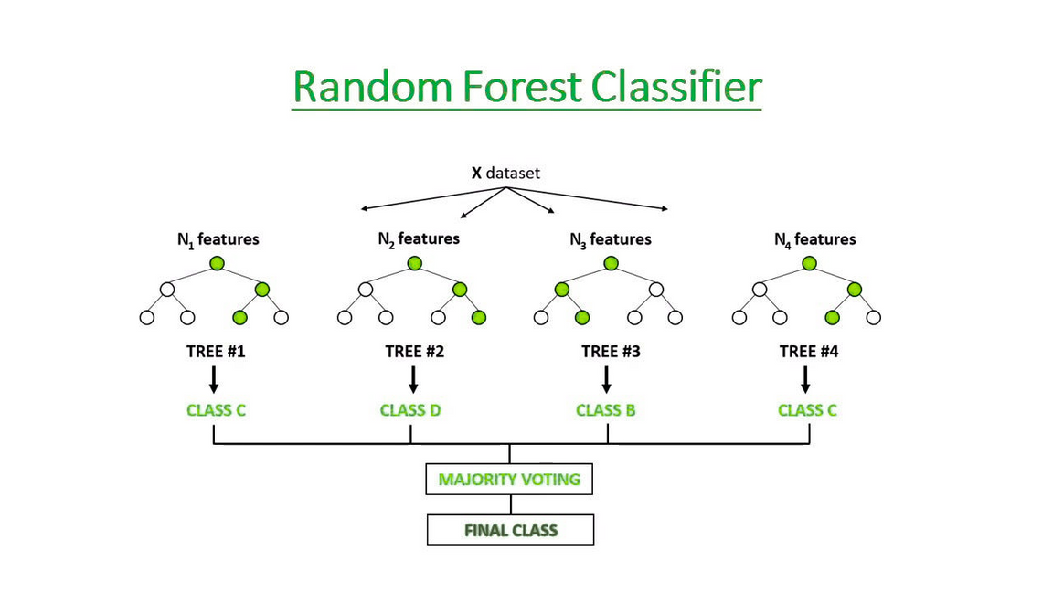
Random Forest Classifier
Random Forest is an ensemble machine learning algorithm that builds multiple decision trees and combines their outputs to improve prediction accuracy.
How It Works:
  Creates many decision trees using random subsets of data and features
  Each tree makes a prediction
  Final output is decided by majority voting
Advantages:
  High accuracy and robustness
  Reduces overfitting compared to single decision trees
  Handles large datasets and missing values well
Applications:
  Fraud detection
  Medical diagnosis
  Recommendation systems
17

Slide 18
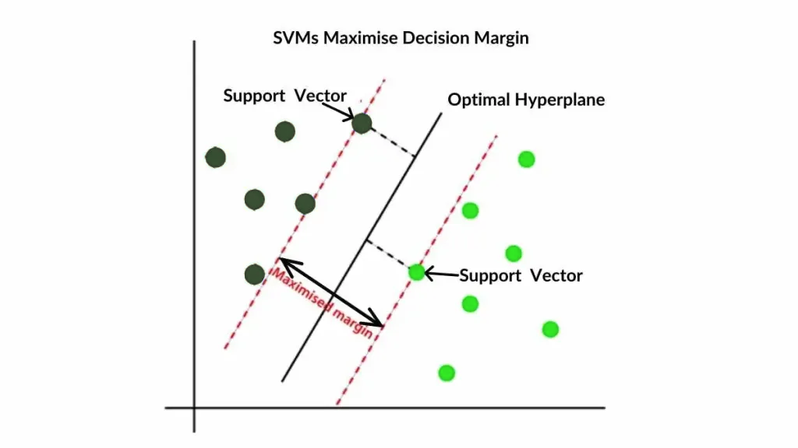
SVC
Support Vector Classification (SVC) is a powerful supervised learning algorithm used for classification by finding the best boundary between classes.
How It Works:
  Identifies the optimal hyperplane that separates classes
  Uses kernel functions for non-linear data
  Maximizes margin between classes
Advantages:
  Works well with high-dimensional data
  Effective for complex decision boundaries
  Less prone to overfitting
Applications:
  Image recognition
  Text classification
  Bioinformatics
18

Slide 19
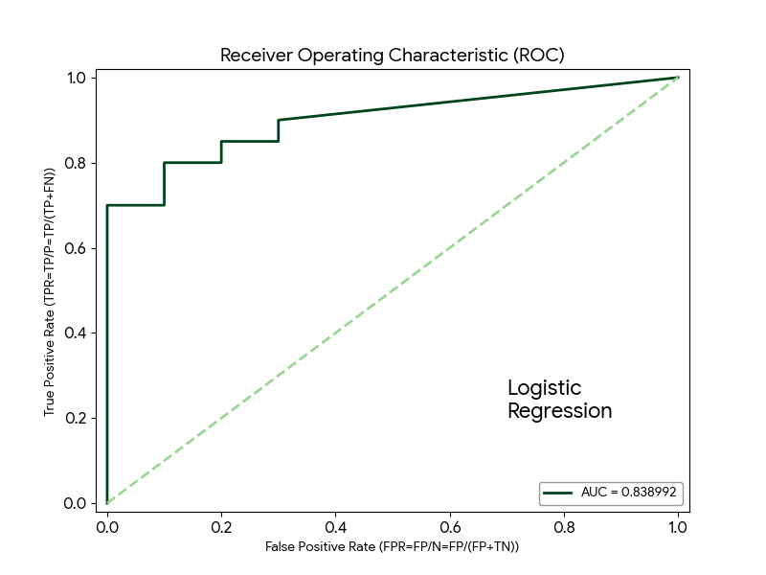
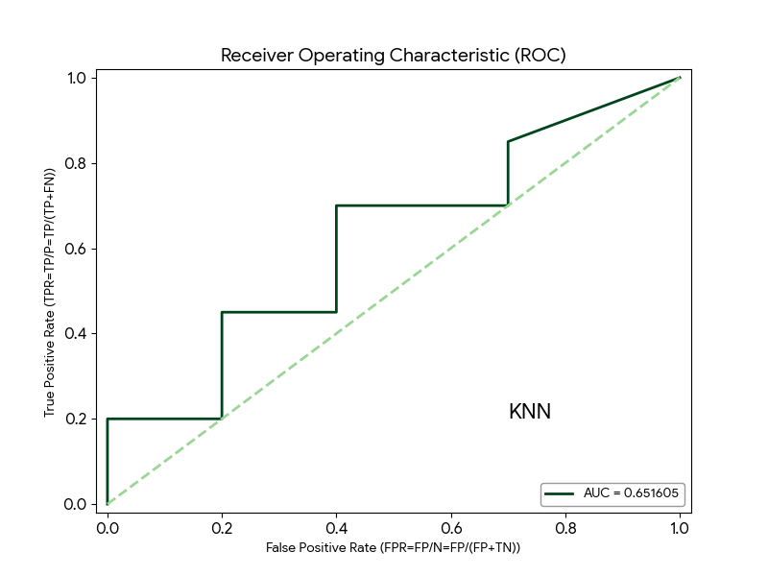
ROC Curves
19

Slide 20
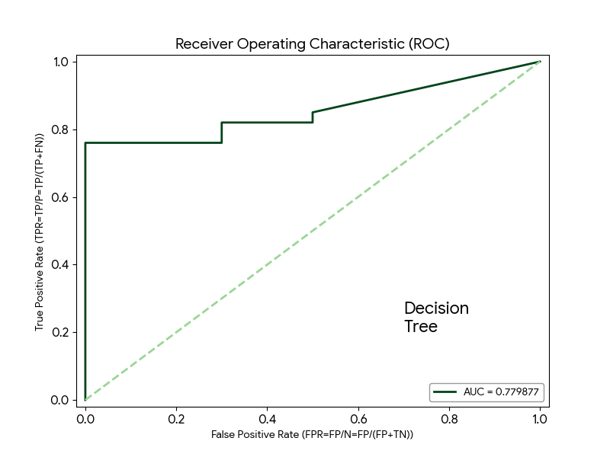
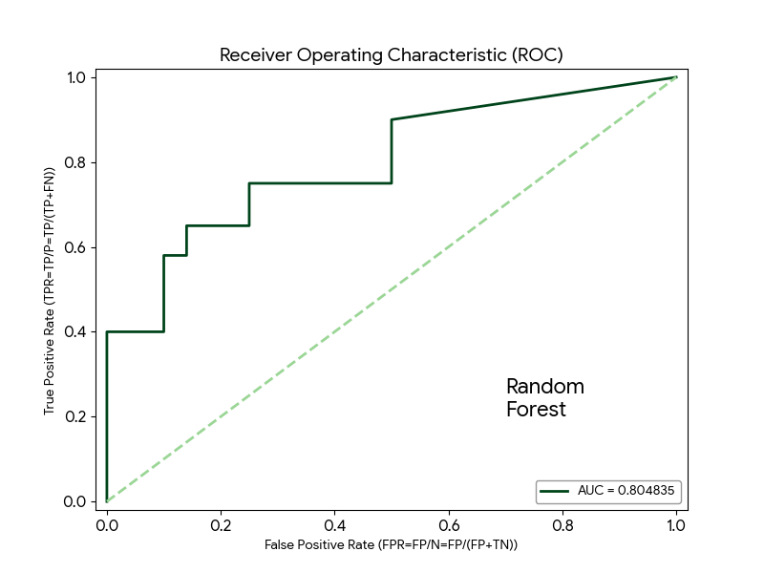
ROC Curves
20

Slide 21
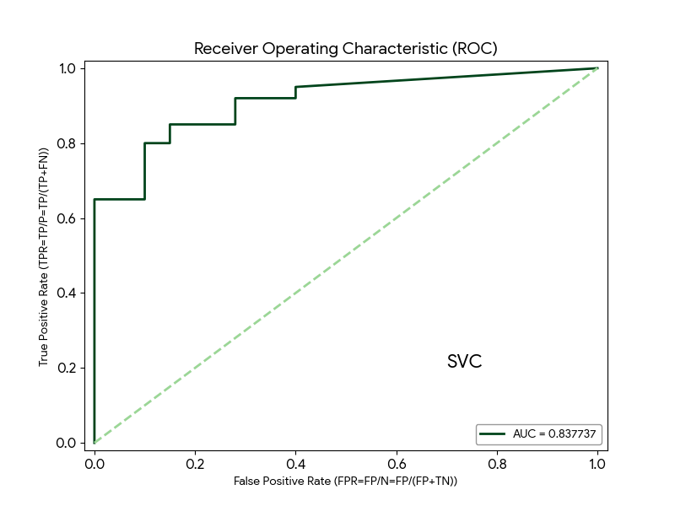
ROC Curves
21

Slide 22
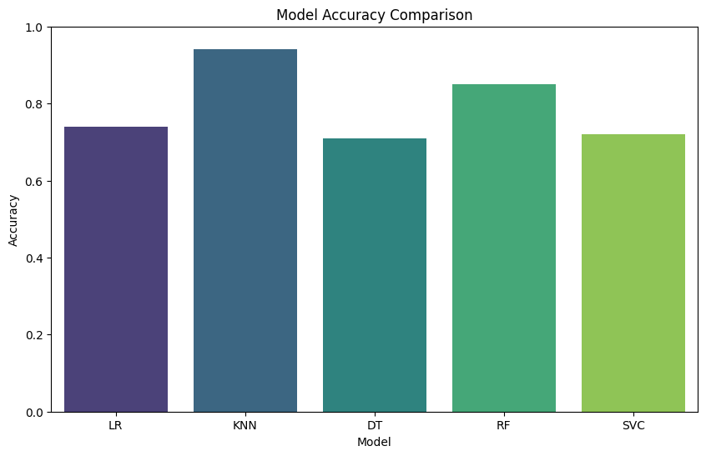
Accuracy Comparison
22

Slide 23
Inference
Model Name | No Stroke (0) | Yes Stroke (1)
Logistic Regression | 723 | 299
KNN | 972 | 12
Decision Tree | 695 | 327
Random Forest | 856 | 166
SVC | 706 | 316
Final Choice: Logistic Regression
1. The Medical Justification: High Recall
In heart stroke detection, the most important metric is Recall (Sensitivity). You want to catch as many actual stroke cases as possible.
  LR caught 40 out of 50 strokes (80% Recall).
  KNN only caught 1 out of 50 strokes (2% Recall). Even though LR has many False Positives (predicting "Yes" 299 times), it ensures that 80% of the people actually having a stroke get flagged for medical attention.
2. Model Interpretability
Unlike "Black Box" models like Random Forest or SVC, Logistic Regression is very transparent.
  It provides coefficients for each feature (like age, hypertension, or heart disease).

Slide 24
Thank You
24

